Slide 1
Lecture Title: Analysis of Algorithms
Course Code: CSC 2211
Course Title: Algorithms
Dept. of Computer Science
Faculty of Science and Technology
Lecture No: | 01 | Week No: | 01 | Semester: | Spring 22-23
Lecturer: | Md. Faruk Abdullah Al Sohan, faruk.sohan@aiub.edu

Slide 2
Analysis of Algorithms
Efficiency:
Running time
Space used
Efficiency as a function of the input size:
Number of data elements (numbers, points).
The number of bits of an input number .

Slide 3
The RAM Model
RAM model represents a “generic” implementation of the algorithm
Each “simple” operation (+, -, =, if, call) takes exactly 1 step.
Loops and subroutine calls are not simple operations, but depend upon the size of the data and the contents of a subroutine. We do not want “sort” to be a single step operation.
Each memory access takes exactly 1 step.
Notes:
Basically, any basic operation that takes a small, fixed amount of time we assume to take just one step.
We measure the run time of an algorithm by counting the number of steps it takes.
Why does this work? For the same reason that the “Flat Earth” model works. In our day-to-day lives we assume the Earth to be flat!
Now, lets look at how we can use this.

Slide 4
The RAM model (cntd..)
It is important to choose the level of detail.
The RAM model:
Instructions (each taking constant time), we usually choose one type of instruction as a characteristic operation that is counted:
Arithmetic (add, subtract, multiply, etc.)
Data movement (assign)
Control flow (branch, subroutine call, return)
Comparison (logical ops)
Data types – integers, characters, and floats

Slide 5
Time complexity familiar tasks
Task
Matrix/vector multiply
Getting a specific element from a list
Dividing a list in half, dividing one halve in half, etc
Binary Search
Scanning (brute force search) a list
Nested for loops (k levels)
Merge Sort
Bubble Sort
Generate all subsets of a set of data
Generate all permutations of a set of data
Growth rate
O(N²)
O(1)
O(log₂N)
O(log₂N)
O(N)
O(N^{k})
O(N log₂N)
O(N²)
O(2^{N})
O(N!)

Slide 6
Insertion Sort
InsertionSort (Array[])
for j=1 to Array.length
key = Array[j]
i = j-1
while i>=0 and Array[i]> key
Array[j+1]=Array[i]
i = i-1
Array[i+1]=key
j
j
j
j
j
j
j
j
j
i
i
i
i
i
i
i
i
i
i
66
22
99
77
11
91
55
88
44
Key
22
11
33
66
33
22
66
33
22
77
66
55
44
99
77
99
77
66
55
99
91
77
66
11
99
91
88
77
91
55
99
91
88
88
99
91
44
99
0
1
2
3
4
5
6
7
8
9

Slide 7
Analysis of Insertion Sort
Time to compute the running time as a function of the input size (exact analysis).
for j := 2 to n do
key := A[j]
// Insert A[j] into A[1..j-1]
i := j-1
while i>0 and A[i]>key do
A[i+1]:=A[i]
i--
A[i+1]:=key
cost c₁
c₂
0
c₃
c₄
c₅
c₆
c₇
times n n-1 n-1 n-1 n-1

Slide 8
Analysis of Insertion Sort
The running time of an algorithm is the sum of the running times of each statement.
A statement with cost c that is executed n times contributes c*n to the running time.
The total running time T(n) of insertion sort is
T(n)= c₁*n + c₂(n-1) + c₃(n-1) + c₄ + c₅ + c₆
+ c₇ (n-1)

Slide 9
Analysis of Insertion Sort
Often the performance depends on the details of the input (not only the length n).
This is modeled by t_{j.}
In the case of insertion sort the time t_{j} depends on the original sorting of the input array.

Slide 10
Performance Analysis
Performance often draws the line between what is feasible and what is impossible.
Often it is sufficient to count the number of iterations of the core (innermost) part.
No distinction between comparisons, assignments, etc (that means roughly the same cost for all of them).
Gives precise enough results.
In some cases, the cost of selected operations dominates all other costs.
Disk I/O versus RAM operations.
Database systems.

Slide 11
Best/ Worst/ Average Case
Best case: works fast on some input.
Worst case: (usually) maximum time of algorithm on any input of size.
Average case: (sometimes) expected time of algorithm over all inputs of size. Need assumption of statistical distribution of inputs.
Analyzing insertion sort’s
Best case: elements already sorted, t_{j}=1, running time ≈ (n-1), i.e., linear time.
Worst case: elements are sorted in inverse order, t_{j} = j-1, running time ≈ (n²-n)/2 , i.e., quadratic time.
Average case: t_{j} = j / 2, running time ≈ (n²+n-2)/4 , i.e., quadratic time.

Slide 12
Best/ Worst/ Average Case
For inputs of all sizes:
worst-case
6n
average-case
5n
best-case
Running time
4n
3n
2n
1n
1 2 3 4 5 6 7 8 9 10 11 12 …..
Input instance size

Slide 13
Best/ Worst/ Average Case
Worst case is usually used:
It is an upper-bound.
In certain application domains (e.g., air traffic control, surgery) knowing the worst-case time complexity is of crucial importance.
For some algorithms worst case occurs fairly often
The average case is often as bad as the worst case.
Finding the average case can be very difficult.

Slide 14
Asymptotic Notation
Asymptotic Notations are languages that allow us to analyze an algorithm's running time by identifying its behavior as the input size for the algorithm increases.
This is also known as an algorithm's growth rate.(Wiki)

Slide 15
Asymptotic Notation
The “big-Oh” O-Notation
asymptotic upper bound
f(n) = O(g(n)), if there exists constants c>0 and n₀>0, s.t. f(n) ≤ c g(n) for n ≥ n₀
f(n) and g(n) are functions
over non- negative integers
Used for worst-case analysis
Running Time
Input Size

Slide 16
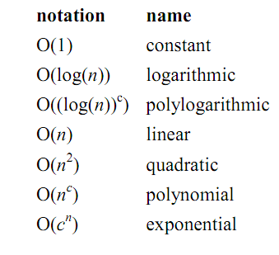
Asymptotic Notation

Slide 17
Asymptotic Notation
The “big-Omega” Ω−Notation
asymptotic lower bound
f(n) = Ω(g(n)) if there exists constants c>0 and n₀>0, s.t. c g(n) ≤ f(n) for n ≥ n₀
Used to describe best-case running times or lower bounds of algorithmic problems.
E.g., lower-bound of searching in an unsorted array is Ω(n).
Running Time
Input Size

Slide 18
Asymptotic Notation
The “big-Theta” Θ−Notation
asymptoticly tight bound
f(n) = Θ(g(n)) if there exists constants c₁>0, c₂>0, and n₀>0, s.t. for n ≥ n₀ c₁ g(n) ≤ f(n) ≤ c₂ g(n)
f(n) = Θ(g(n)) if and only if f(n) = Ο(g(n)), f(n) = Ω(g(n))
O(f(n)) is often abused instead of Θ(f(n))
Running Time
Input Size

Slide 19
Asymptotic Analysis
Goal: to simplify the analysis of the running time by getting rid of details, which are affected by specific implementation and hardware
rounding of numbers: 1,000,001 ≈ 1,000,000
rounding of functions: 3n² ≈ n²
Capturing the essence: how the running time of an algorithm increases with the size of the input in the limit.
Asymptotically more efficient algorithms are best for all but small inputs

Slide 20
Asymptotic Analysis
Simple Rule: Drop lower order terms and constant factors.
50 n log n is O(n log n)
7n - 3 is O(n)
8n² log n + 5n² + n is O(n² log n)
Note: Although (50 n log n) is O(n⁵), it is expected that an approximation is of the smallest possible order.

Slide 21
Correctness of Algorithms
An algorithm is correct if for any legal input it terminates and produces the desired output.
Automatic proof of correctness is not possible (so far).
There are practical techniques and rigorous formalisms that help to reason about the correctness of (parts of) algorithms.

Slide 22
Partial and Total Correctness
Partial correctness
IF this point is reached,
THEN this is the desired output
Any legal input
Algorithm
Output
Total correctness
INDEED this point is reached,
AND this is the desired output
Any legal input
Algorithm
Output

Slide 23
Assertions
To prove partial correctness, we associate several assertions (statements about the state of the execution) with specific checkpoints in the algorithm.
E.g., A[1], …, A[ j ] form an increasing sequence
Preconditions – assertions that must be valid before the execution of an algorithm or a subroutine (INPUT).
Postconditions – assertions that must be valid after the execution of an algorithm or a subroutine (OUTPUT).

Slide 24
Loop invariants
Loop Invariant: is a property of a program loop that is true before (and after) each iteration.
Initialization: It is true prior to the first iteration of the loop.
Maintenance: If it is true before an iteration of the loop, it remains true before the next iteration.
Termination: When the loop terminates, the invariant gives us a useful property that helps show that the algorithm is correct.

Slide 25
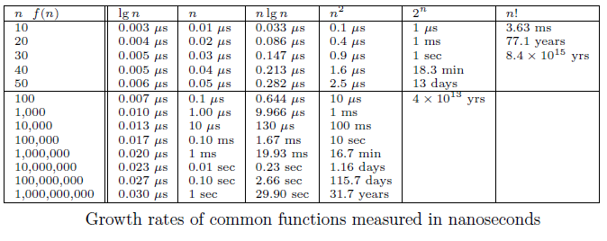
Growth Rates and Dominance Relations

Slide 26
Proof by Induction
We want to show that property P is true for all integers n ≥ n₀.
Basis: prove that P is true for n₀.
Inductive step: prove that if P is true for all k such that n₀ ≤ k ≤ n – 1 then P is also true for n.
Example
Basis

Slide 27
Proof by Induction
Inductive Step

